Slide 1

Machine learning
Analysis of car details and heart Disease Datasets
Sangeetha E
60524OLE004

Slide 2
Introduction to Regression and Classification in Machine Learning
Regression and classification are two primary types of supervised learning tasks in machine learning. Both involve predicting outcomes based on input data, but they serve different purposes and are used in different contexts.

Slide 3
Common Regression Algorithms
Regression is used to predict a continuous numerical outcome based on input features. It models the relationship between one or more independent variables (features) and a dependent variable (target).

Slide 4
Linear Regression: Models the relationship using a straight line (y = mx + b).
Polynomial Regression: Extends linear regression to model non-linear relationships.
Ridge and Lasso Regression: Regularization techniques to prevent overfitting.
Support Vector Regression (SVR): Uses support vector machines for regression tasks.

Slide 5
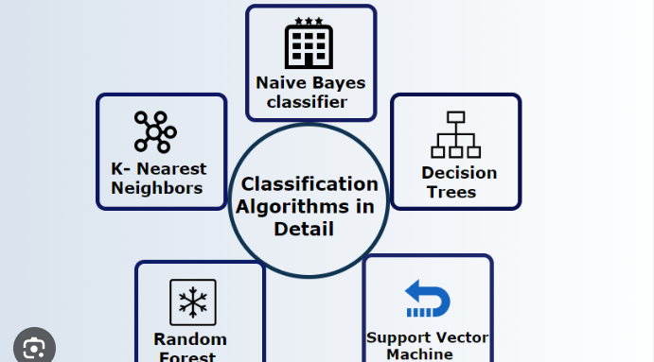
common classification algorithms
Classification is used to predict categorical outcomes based on input features. It assigns input data into predefined classes or categories

Slide 6
Common Classification Algorithms:
Logistic Regression: Although it has "regression" in its name, it's used for binary classification tasks.
Decision Trees: Tree-like models that split data based on feature values to classify it.
Random Forest: An ensemble of decision trees that improves accuracy and robustness.
Support Vector Machines (SVM): Finds the hyperplane that best separates classes in the feature space.
Neural Networks: Especially effective for complex classification tasks, such as image and speech recognition.

Slide 7
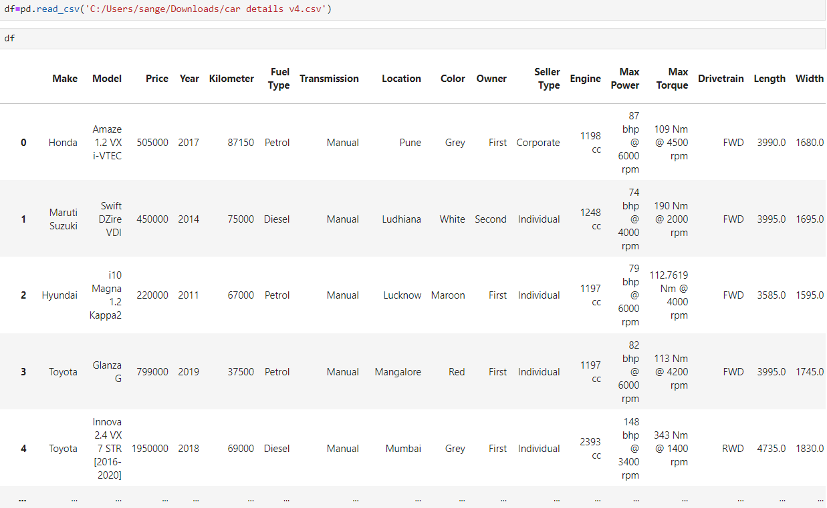
Car details
CAR DETAILS: Make and model, Year of manufacture, Body type, engine specification, Mileage, Price, Warranty Information, Condition Etc,

Slide 8
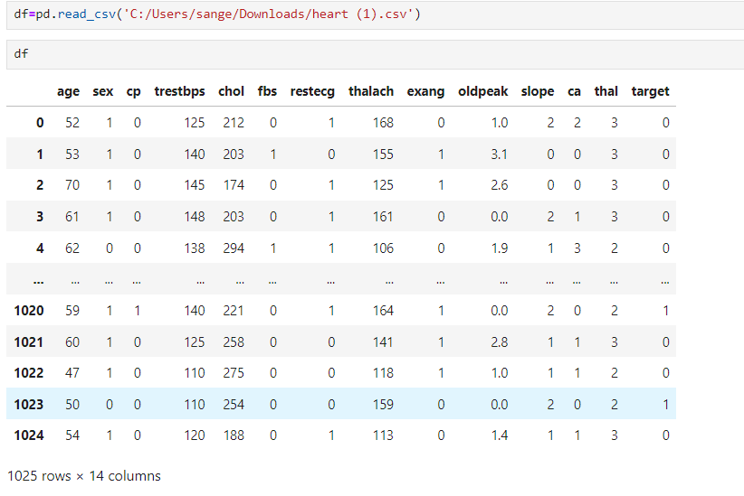
HEART DISEASE DATASET
Heart disease dataset: A heart disease dataset typically contains various medical and demographic attributes used to predict the presence or absence of heart disease.
Common Features in a Heart Disease Dataset : Age, Sex, Chest pain type, Resting blood pressure, Fasting blood sugar, Target variable etc,

Slide 9
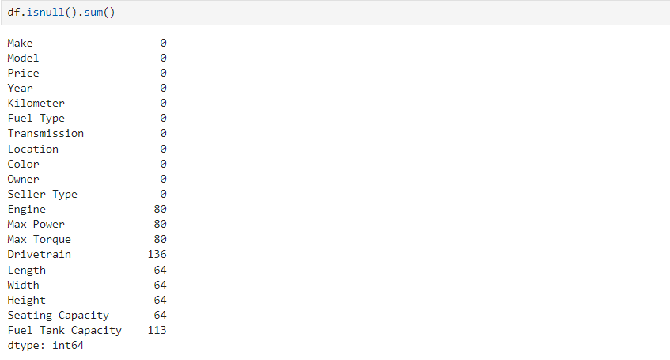
Car Price Prediction
Addressed missing values

Slide 10
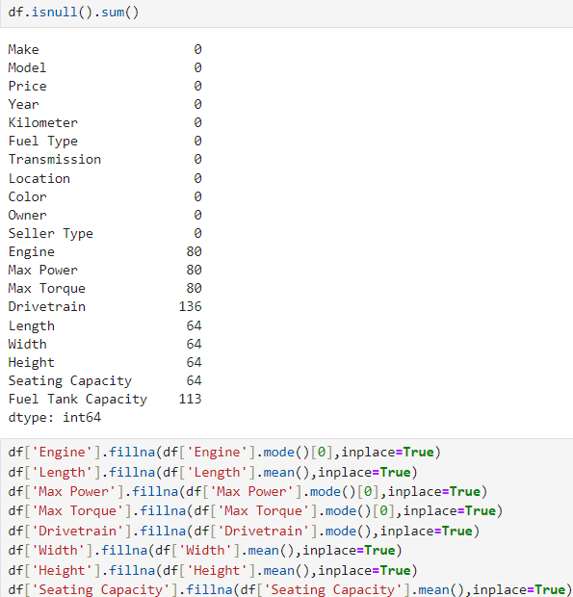
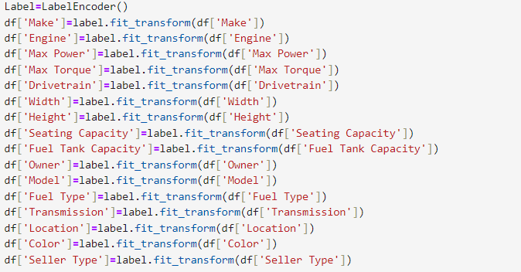
Categorical Change to Numeric
Categorical change to Numeric: Converting categorical data to numeric format is a crucial step in preparing data for machine learning models.
Example: Low, Medium, High

Slide 11
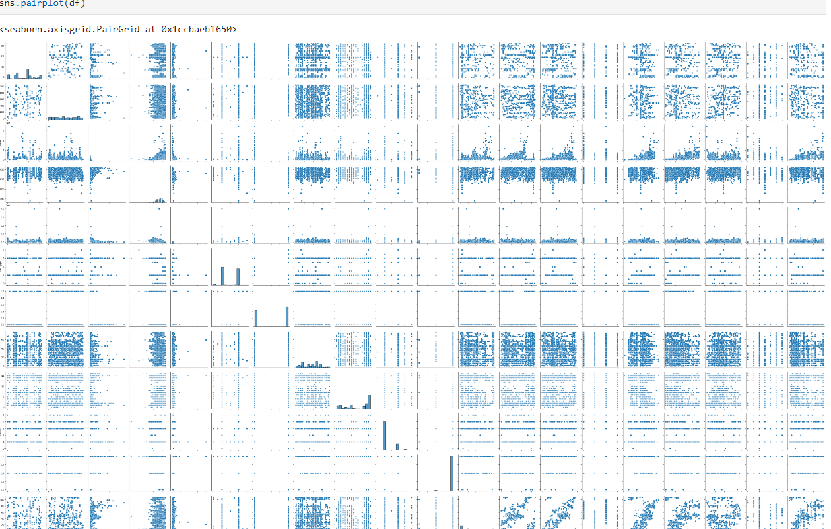
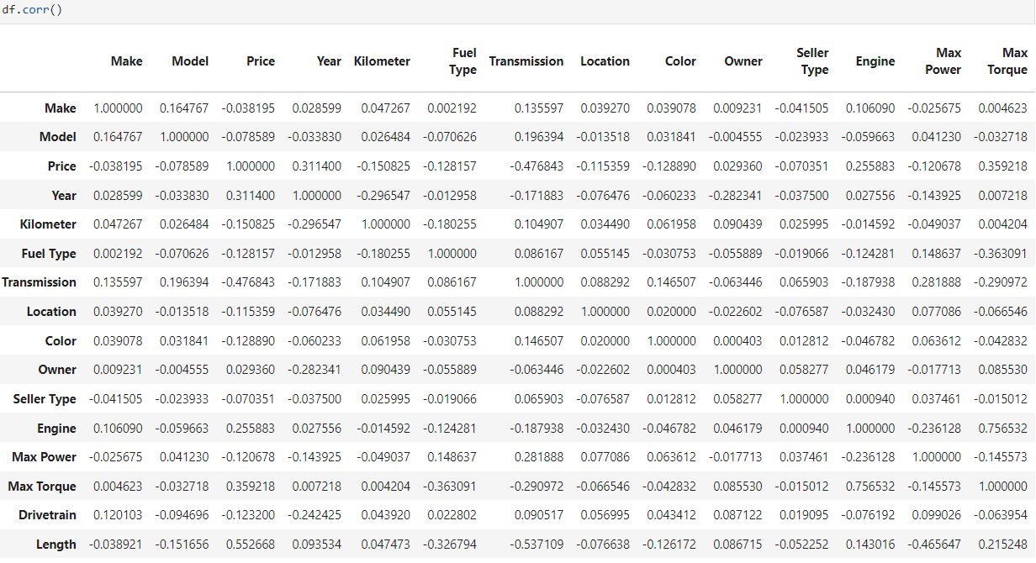

Slide 12
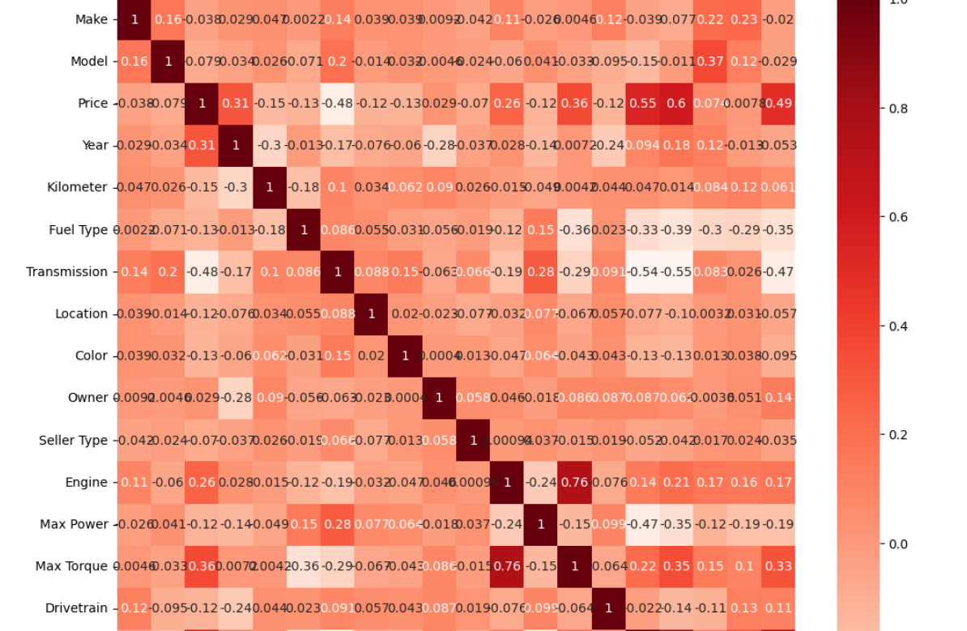
a=df.corr()
plt.figure(figsize=(12,12))
sns.heatmap(a,annot=True, cmap='Reds’)
plt.show()
A heatmap is a great way to visualize data in a matrix format, and it can be particularly useful for representing the confusion matrix in classification tasks.

Slide 13
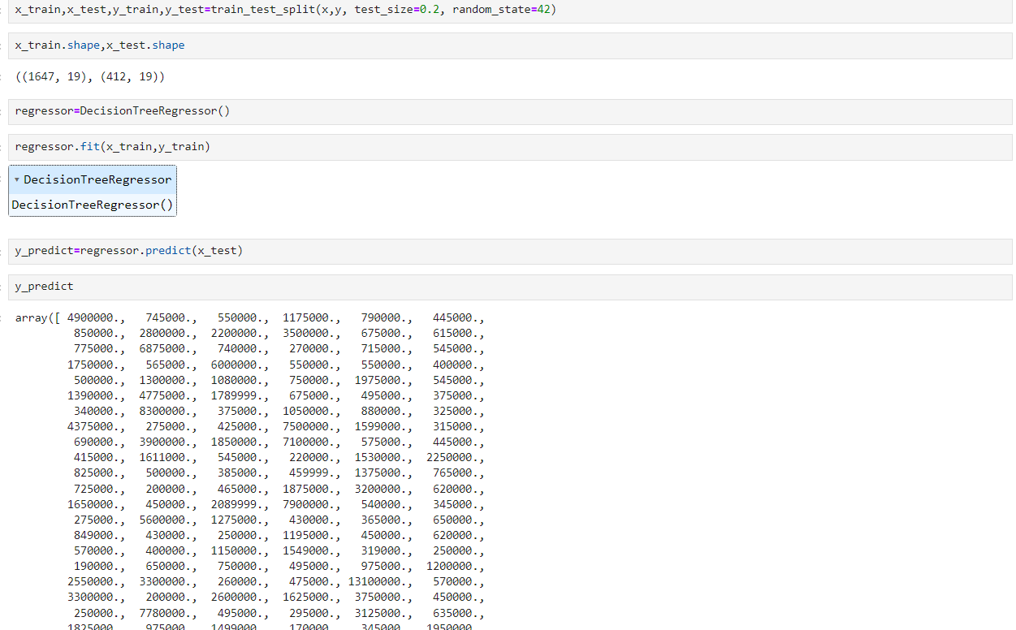
The Decision Tree Regressor is a supervised learning algorithm used for regression tasks. It models the relationship between features and a continuous target variable by splitting the data into subsets based on feature values, forming a tree-like structure.

Slide 14
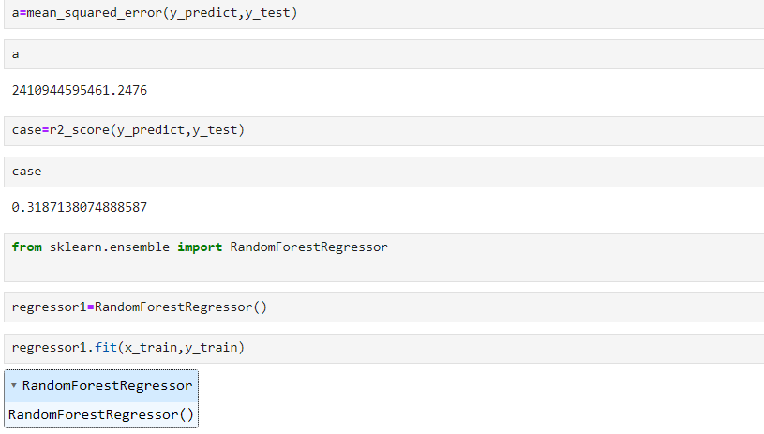
Random forest regressor
Random Forest is an ensemble learning method that can be used for regression tasks. It builds multiple decision trees and merges them to obtain a more accurate and stable prediction.

Slide 15
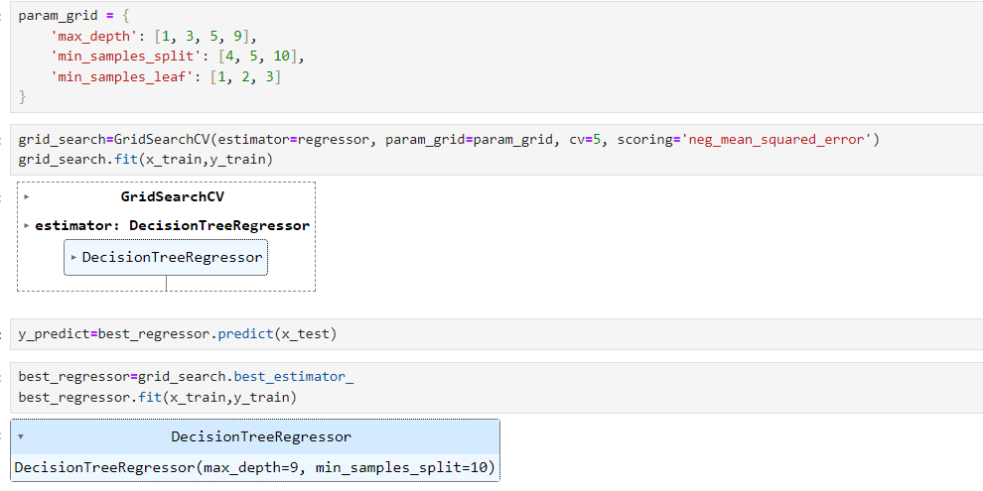
The Decision Tree Regressor is a supervised learning algorithm used for regression tasks. It models the relationship between features and a continuous target variable by splitting the data into subsets based on feature values, forming a tree-like structure.

Slide 16
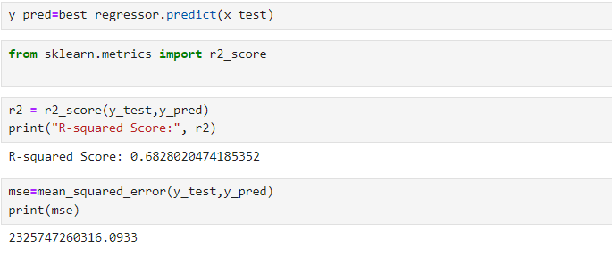
Using GridSearchCV effectively can help reduce prediction errors by optimizing hyperparameters for machine learning models. Here’s how to leverage GridSearchCV to minimize errors and improve model performance

Slide 17
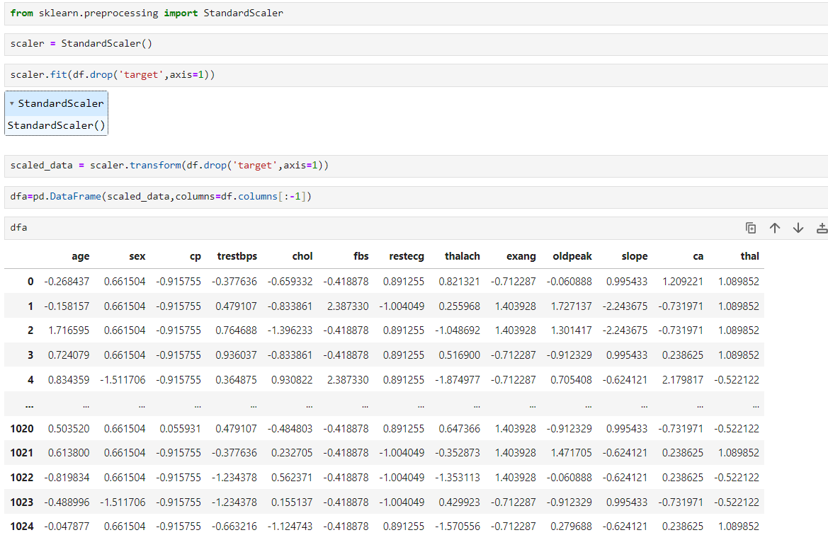
STANDARD SCALER
Standard scaler : The Standard Scaler is a technique used in data preprocessing to standardize the features of your dataset. It transforms the data so that it has a mean of 0 and a standard deviation of 1. This is particularly useful for algorithms that assume normally distributed data or are sensitive to the scale of the data, such as gradient descent-based algorithms.

Slide 18
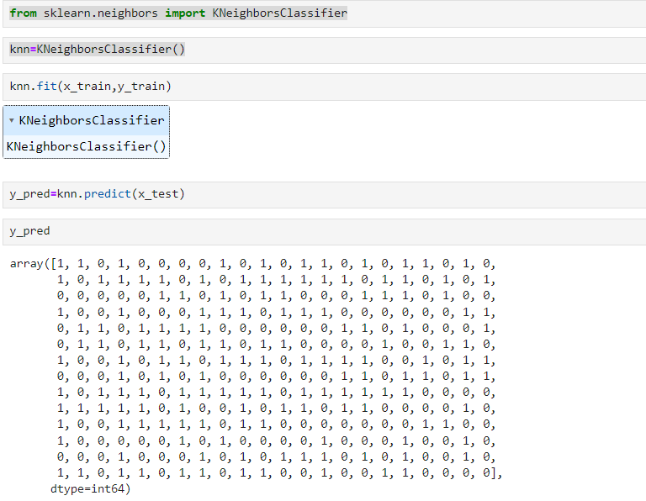
KNEIGHBORS CLASSFIER
The KNeighborsClassifier is a popular machine learning algorithm used for classification tasks based on the k-nearest neighbors (k-NN) approach. It classifies a data point based on how its neighbors are classified, relying on the proximity of data points in the feature space.

Slide 19
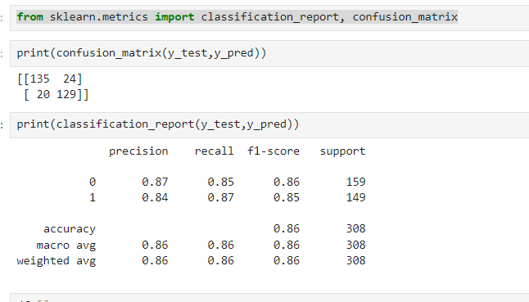
The classification report and confusion matrix functions from sklearn.metrics are useful for evaluating the performance of classification models.
Confusion Matrix
A confusion matrix is a table that summarizes the performance of a classification algorithm. It shows the true vs. predicted classifications for a binary or multi-class problem.

Slide 20
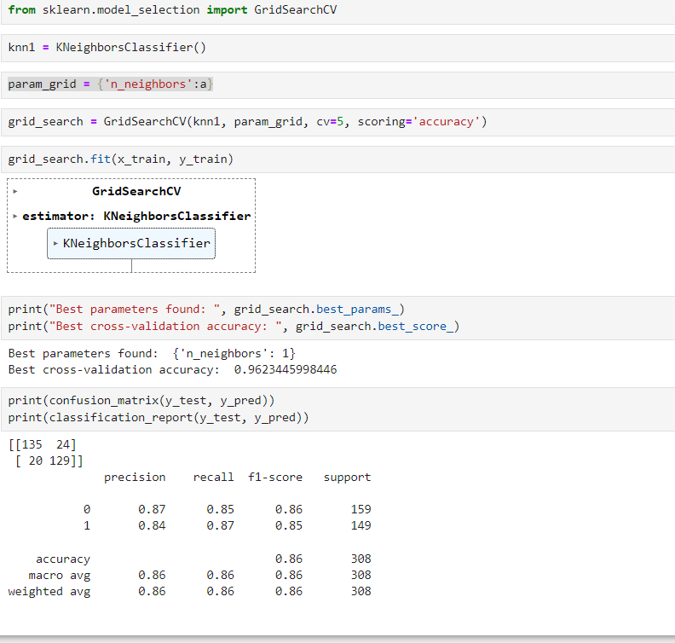
When you perform a grid search, you are systematically testing a combination of parameters to find the best configuration for your model. The best_ params attribute gives you the optimal parameters found during the search, while best_score_ provides the best cross-validation accuracy achieved with those parameters.

Slide 21


